Slide 1
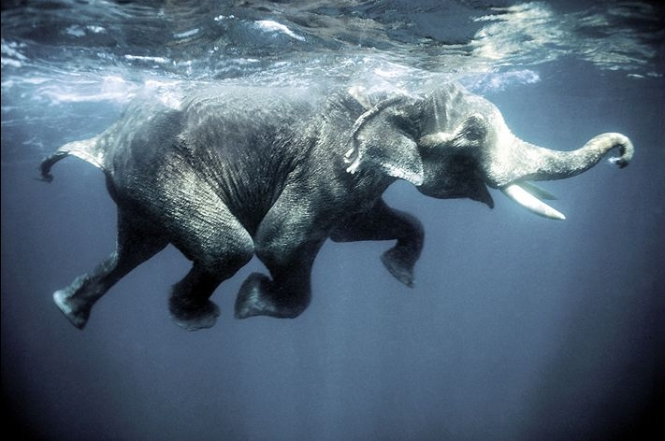
Steps to the Decision Making Process
Don’t Laugh While Drowning Elephants

Slide 2
Step #1
Define the Problem
-Examine the situation.
-What decisions need to be made?
-Consider
Everything
involved

Slide 3
Step #2
List the Options
-What are the possible choices you could make?
-Share your options
with others.
-Ask for advice.

Slide 4
Step #3
Weigh the options/outcomes
-Apply criteria to eliminate any solutions
-Does it follow values?
-Is it safe, legal, healthy etc…

Slide 5
Step #4
Make a Decision and act on it
-Use everything you know to make a responsible decision.
-Feel good about your
decision if you really
thought it through.

Slide 6
Step #5
Evaluate your decision
-Reflect on what happened.
-Did it turn out the way you thought it would?
-Would you do the same
thing if faced with this
situation again?

